Slide 1

Chuckery Primary School
Mathematics
Parental Workshop
Year one and Year two
Number skills

Slide 2
Welcome
Agenda
Introduction to our approach to Maths at Chuckery Primary School.
Why partnership is so important for our children
Sharing our calculation policy to support your Year One or Year Two child at home.
Opportunity to work with your child in class.

Slide 3
Mathematics at Chuckery
All learning is based on the expectations outlined in the Year one and Year two National Curriculum.
Your Year One or Year Two child will receive a daily formal session of Mathematics with their class teacher.
During a lesson , your child will develop a deeper understanding of a concept and its application rather than just merely learning a calculation method.
We aim for children to develop efficient mental strategies, as well as efficient written approaches to calculations.
Work may focus on new concepts, revisiting methods or developing concepts through reasoning and problem solving.
Each pupil will receive feedback in the moment , marking away from the child can lead to misconceptions and future difficulties.
In your childs books, teachers will give feedback in green and your child may make corrections in purple pen.

Slide 4
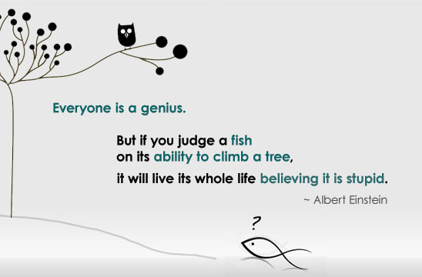
How do you support my child?
All children learn at different paces so all children need to be treated as individuals in the classroom. Provision for your child ensures that they are accessing the learning at their current level of understanding.
Children may have a focussed additional short session with an adult in the classroom if they need extra support or challenge.
All children have resources in the classroom and a supportive environment in which to learn.
Children are encouraged to be independent learners but we always have an extra adult in the classroom to support or prompt thinking when it is needed .
All children receive feedback about their work. This is in the moment , verbal or written feedback which means if your child makes an error , this will be addressed so they don’t become confused.
This Photo by Unknown Author is licensed under CC BY-SA

Slide 5
Why partnership BETWEEN HOME AND SCHOOL is so important for our children
Children often mirror their parents views and opinions about Mathematics – this means that if parents appear not to be confident at Maths , their child will also exhibit similar behaviour.
At Chuckery we believe in the power of YET . Developing a growth mindset is important in developing the children’s confidence. Mistakes are seen as positive learning opportunities and we never talk about making errors as a ‘bad thing’ merely that we haven’t mastered the approach yet .
When parents work with school and adopt the same approach to understanding it means that children have a consistent approach to learning and avoid unnecessary confusion.

Slide 6
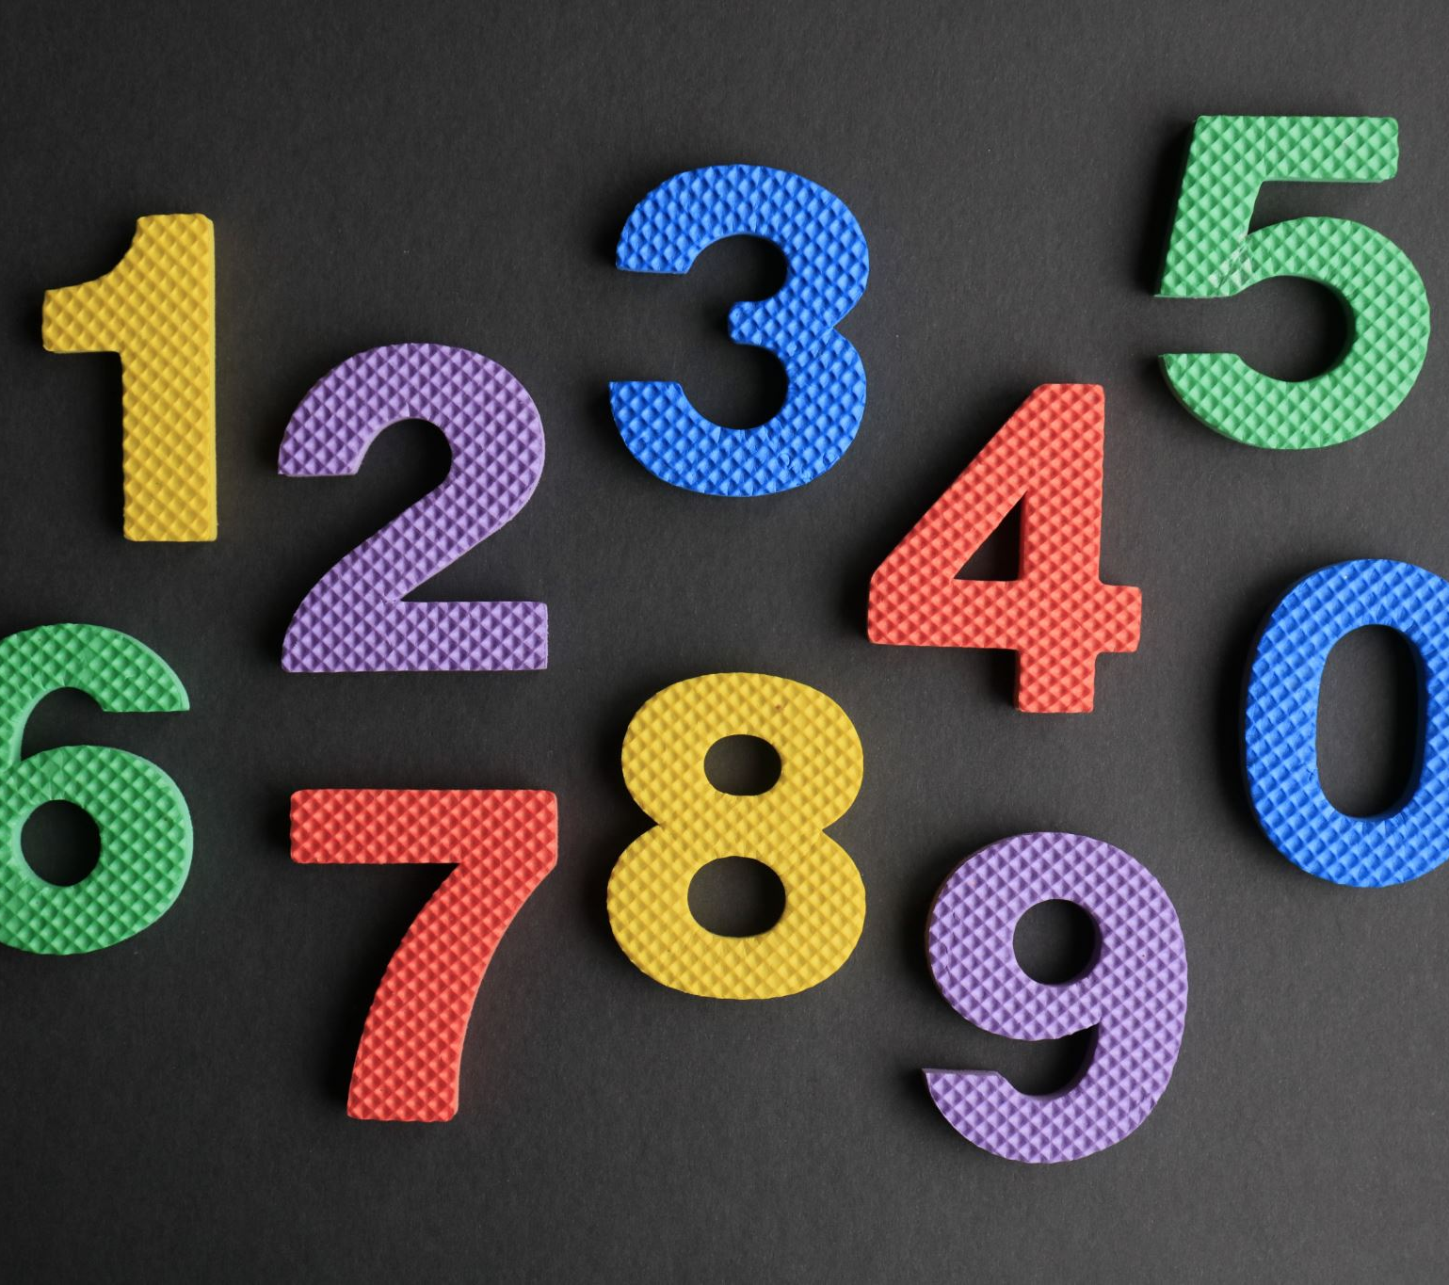
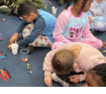
our calculation policy
We approve of the key ideas suggested by curriculum designers to support children in school
The first is the development of declarative facts . These are things children simply need to know. In Years One and Two , this includes our number bonds to 10 and within 20 , and counting in steps of 2,5,10 and in year Two , the development of our 3 times tables too. Elements of these are rehearsed daily with children during lesson time.
We use a CPA approach to learning new calculations . This means Concrete , Pictorial and Abstract . This approach allows the development of a deeper understanding of new concepts and ideas.
We believe in contextualised learning . This means exposing children to real life problems and reasoning ,and real world mathematics.

Slide 7
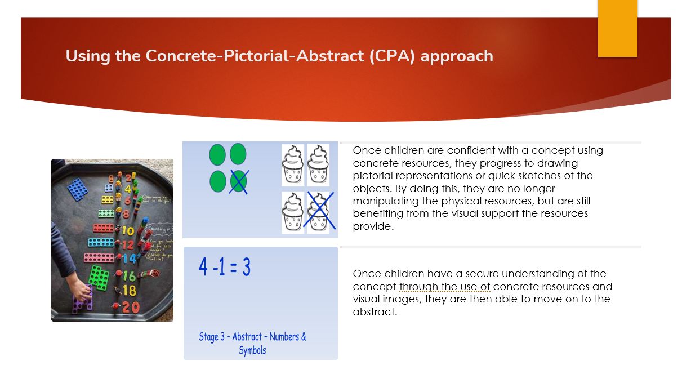

Slide 8
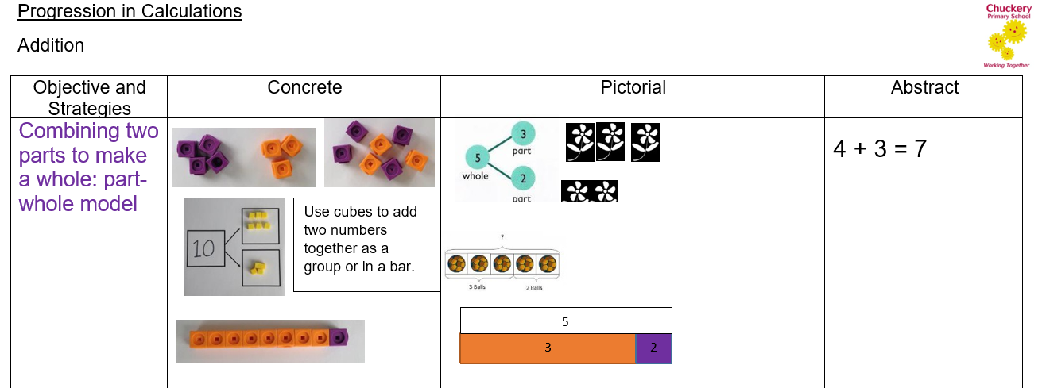
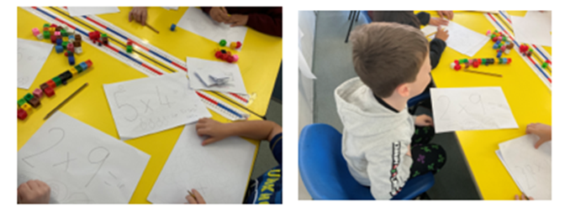
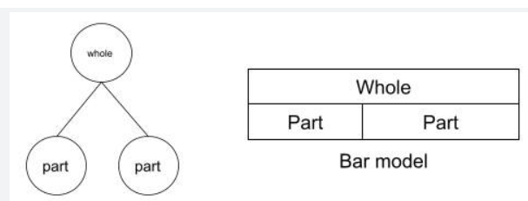
Calculation policy (hand out)
Year One and Two main calculation methods are outlined in your handout . These include how we present calculations in class for the four areas of mathematics . Children will move through the Concrete understanding before moving onto a pictorial representation and finally being able to write this as a written calculation which we call abstract.

Slide 9
At home
Encourage your child to be able to identify numbers and seek patterns . Instantly being able to identify the numbers on a dice , grouping numbers together and forming number bonds to ten , within 20 and then to 100 by the end of year two.
Practise times tables daily , counting back wards and forwards to and from 0 and in steps of 2,5 or 10 from any given number eg 2,12,22,32 etc
Use the calculation policy shared with you to practise approaches at home to embed learning
Use clocks to tell the time first hours, then half hour times and eventually read at 5 minute intervals.
Look at weights on cupboard food items and compare heavier and lighter objects.
Pour water into different size containers and read scales on jugs to look at litres , centilitres and mililitres
Use tape measures and rulers to talk about how long or short an object is.
Let children play with coins and pay with small amounts – look at the value of coins and notes together – how many ways can we make 10p ? 20p? 45p ? £1
Watch Numberblocks on Cbeebies and play board games and games of strategy such as drafts or chess (– these are about pattern and reasoning!)
Have fun with 2d shapes to make pictures , spot 3d shapes in the shops and when out and about.
Most importantly make maths fun and don’t share any anxiety you have about number work!

