Slide 1

Chuckery Primary School
Mathematics
Parental Workshop
Year three and Year four
Number skills
Notes:
Welcome
Basis of this workshop is to give a flavour of how we teach calculation strategies in Maths at Chuckery in Years one and two
A separate workshop will be held to look at elements of the curriculum where we examine our delivery of shape , space, measure , fractions and data.
We will also hold an additional session later in the year around effective mental strategies and how to support this at home.
If you do have any comments regarding this presentation , please do feel free to ask either myself or your childs class teacher . Alternatively , you can always email me directly on the school postbox email address and I will be happy to answer any queries you may have or take on board helpful suggestions for future sessions.

Slide 2
Welcome
Agenda
Introduction to our approach to Maths at Chuckery Primary School.
Why partnership is so important for our children
Sharing our calculation policy to support your Year 3 or Year 4 child at home.
Opportunity to work with your child in class.

Slide 3
Mathematics at Chuckery
All learning is based on the expectations outlined in the Year three and Year four National Curriculum.
Your Year three or Year four child will receive a daily formal session of Mathematics with their class teacher.
During a lesson , your child will develop a deeper understanding of a concept and its application rather than just merely learning a calculation method.
We aim for children to develop efficient mental strategies, as well as efficient written approaches to calculations.
Work may focus on new concepts, revisiting methods or developing concepts through reasoning and problem solving.
Each pupil will receive feedback in the moment , marking away from the child can lead to misconceptions and future difficulties.
In your child’s books, teachers will give feedback in green and your child will make corrections in purple pen.
Notes:
National curriculum objectives for year 1 and 2 are clear and are available on the government website . Links to this and other helpful websites are available on the school website under the curriculum tab.
A word on assessment
Assessment at school in ongoing and mainly conducted through teacher assessments as they know your child best while in school. We do carry out formal assessments through test papers twice a year to support teacher judgements . These are done in a way that does not put pressure on the children , they are conducted as quizzes or activity booklets in year one . In year 2 , children do undertake the formal SATs test for Maths where they will under go an arithmetic paper and reasoning paper. Again , although this is formal , there is no pressure on the children and tests are conducted in the classroom with their familiar adults

Slide 4

How do you support my child?
All children learn at different paces so all children need to be treated as individuals in the classroom. Provision for your child ensures that they are accessing the learning at their current level of understanding.
Children may have a focussed additional short session with an adult in the classroom if they need extra support or challenge.
All children have resources in the classroom and a supportive environment in which to learn.
Children are encouraged to be independent learners but we always have an extra adult in the classroom to support or prompt thinking when it is needed .
All children receive feedback about their work. This is in the moment , verbal or written feedback which means if your child makes an error , this will be addressed so they don’t become confused.
This Photo by Unknown Author is licensed under CC BY-SA
Notes:
A note on children with SEND or G and T tendencies , these children are also given their own push to support their learning

Slide 5
Why partnership BETWEEN HOME AND SCHOOL is so important for our children
Children often mirror their parents views and opinions about Mathematics – this means that if parents appear not to be confident at Maths , their child will also exhibit similar behaviour. Please appear confident when talking about Maths, even if you’re not. This will help your child feel confident in their approach too.
At Chuckery we believe in the power of YET . Developing a growth mindset is important in developing the children’s confidence. Mistakes are seen as positive learning opportunities and we never talk about making errors as a ‘bad thing’ merely that we haven’t mastered the approach yet .
When parents work with school and adopt the same approach to understanding it means that children have a consistent approach to learning and avoid unnecessary confusion.
Notes:
Better learning behaviours and Growth mindset

Slide 6
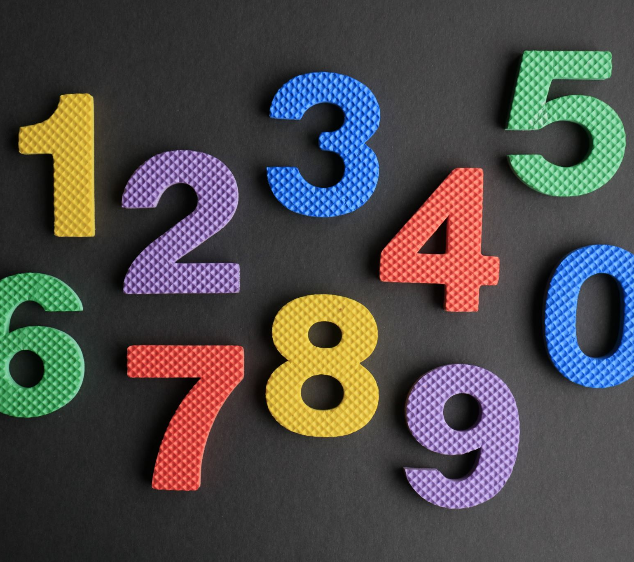
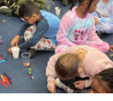
our calculation policy
We approve of the key ideas suggested by curriculum designers to support children in school
The first is the development of declarative facts . These are things children simply need to know. In Years three and four , this includes applying our number bonds to calculations including THTU as well as learning all the times tables and associated division facts to 12x12.
We use a CPA approach to learning new calculations . This means Concrete , Pictorial and Abstract . This approach allows the development of a deeper understanding of new concepts and ideas.
We believe in contextualised learning . This means exposing children to real life problems and reasoning ,and real world mathematics.
Notes:
Declarative, procedural learning and contextual learning form the basis of out appraoch to mathe

Slide 7
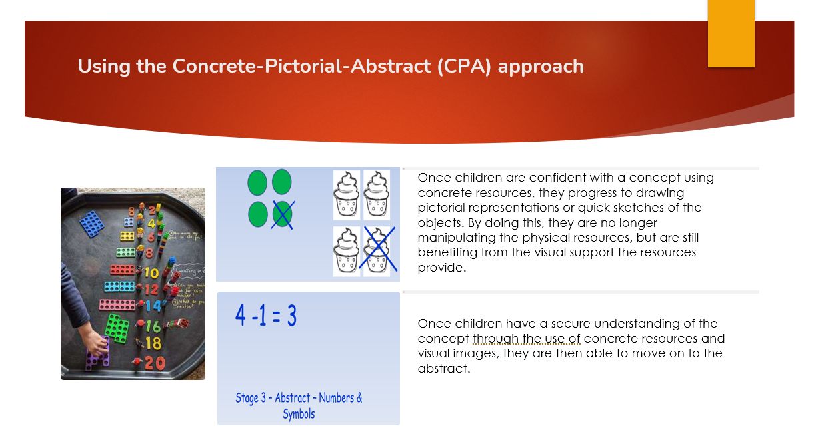

Slide 8
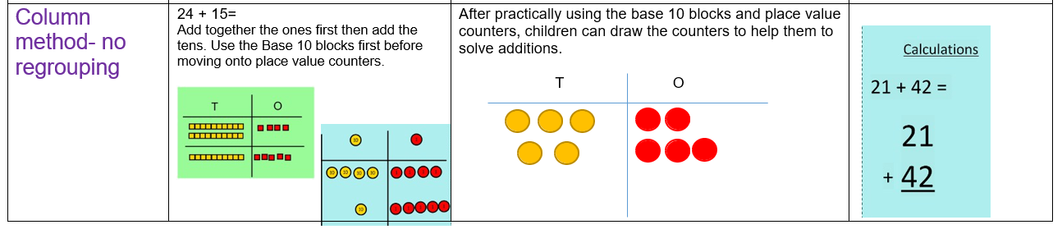
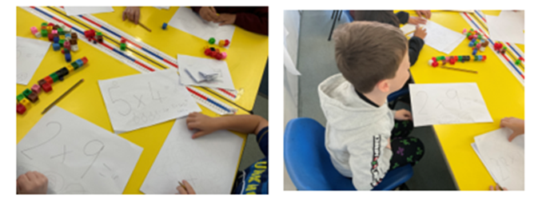
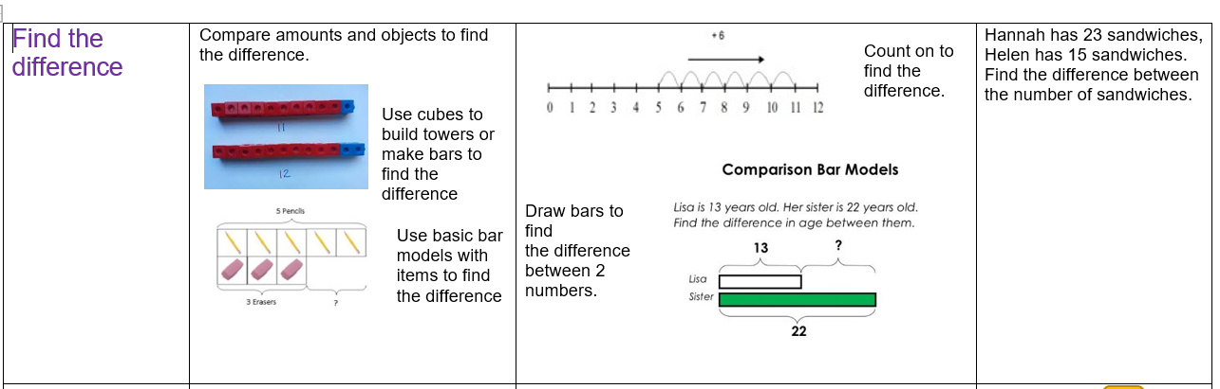
Calculation policy (hand out)
Year three and four main calculation methods are outlined in your handout . These include how we present calculations in class for the four areas of mathematics . Children will move through the Concrete understanding before moving onto a pictorial representation and finally being able to write this as a written calculation which we call abstract.

Slide 9
At home
Encourage your child to be able to identify numbers and seek patterns . Instantly being able to identify times tables by the end of year 4 will lead them well on the way to a fast track success in Mathematics.
Practise times tables daily and use them in real world application . Eg If I bought three of these how much would it cost?
Use the calculation policy shared with you to practise approaches at home to embed learning
Use clocks to tell the time and compare digital and analogue clocks . Use timers, schedules and timetables to support this.
Look at weights on cupboard food items and compare how much a container will hold- what does a litre look like , how much can a cup hold ?etc.
Pour water into different size containers and read scales on jugs to look at litres , centilitres and mililitres
Use tape measures and rulers ;discuss distance in miles and kilometers and compare them.
Let children play with coins and make amounts and then calculate change
Watch Numberblocks on Cbeebies and play board games and games of strategy such as drafts or chess (– these are about pattern and reasoning!)
Have fun with 2d shapes to make pictures , spot 3d shapes in the shops and when out and about.
Most importantly make maths fun and don’t share any anxiety you have about number work!

