Slide 1
In PHSE…
We understand the characteristics of positive friendships.
We are aware of the importance of every family.
We know how families care and support each other.
We develop our confidence in talking, listening and thinking about feelings.
We recognise unsafe situations and are able to protect ourselves, asking for help and support.
We all agree on how to treat each other during these lessons and that everyone feels comfortable and safe to take part.
family respect positive relationships safety protect responsibility talking listening feelings care support confidence protect

Slide 2
We are learning about some of the physical changes that happen during puberty
We will be able to:
identify some of the external and internal changes that happen to bodies during puberty.
explain what happens during menstruation (periods).
explain what is meant by ejaculation and wet dreams.

Slide 3
SRE – Read these GROUNDRULES to yourself
Any questions?
ASK IT BOX!
Any questions go on a post-it into the box – an adult will then respond accordingly. Your questions can be anonymous.

Slide 4
Help I'm Hairy RSE Film | EasySRE

Slide 5
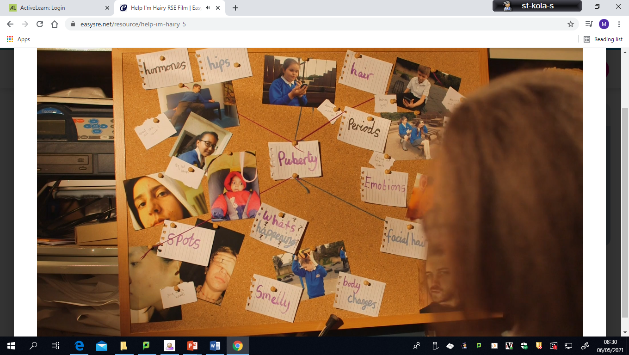

Slide 6
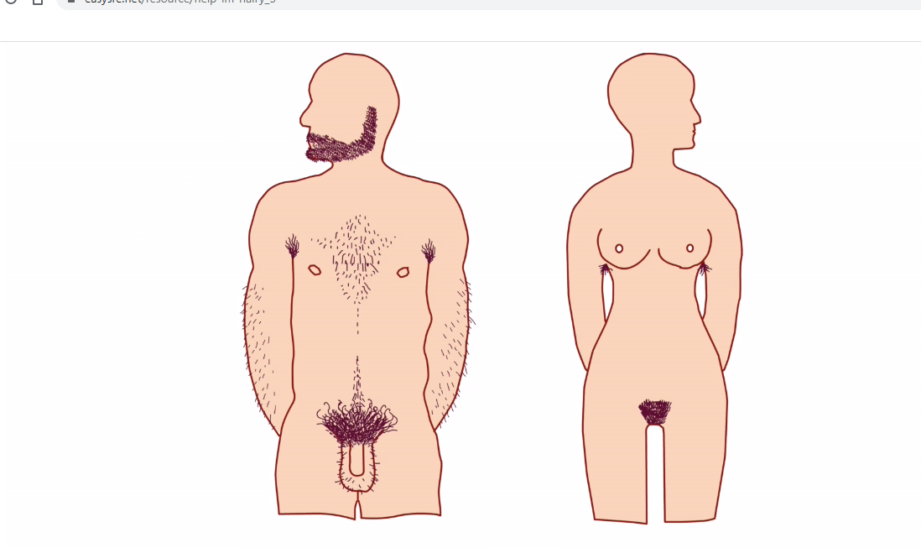

Slide 8
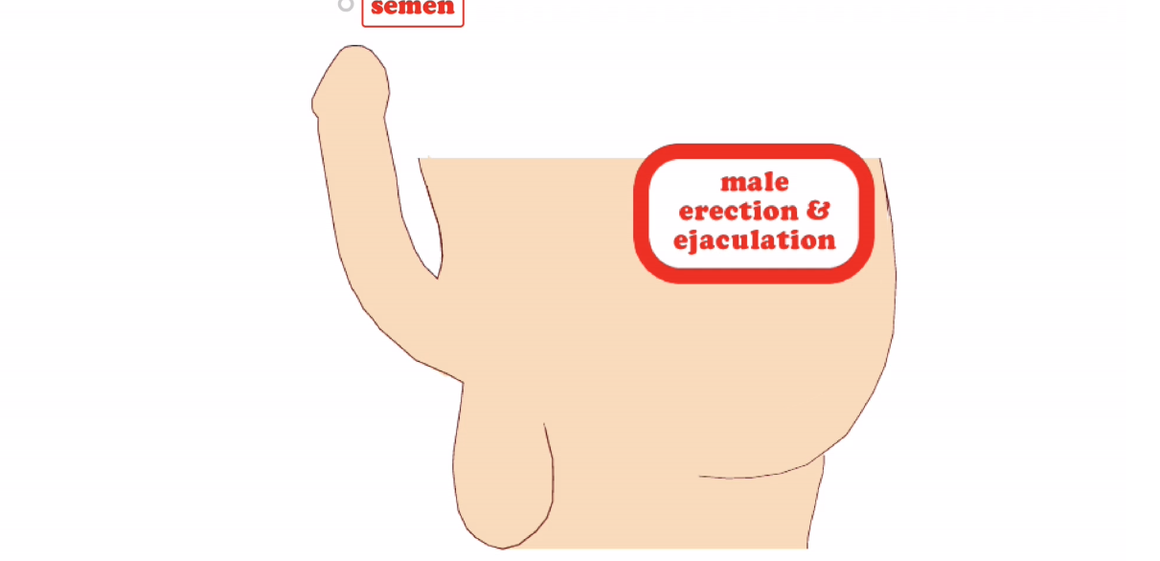

Slide 9
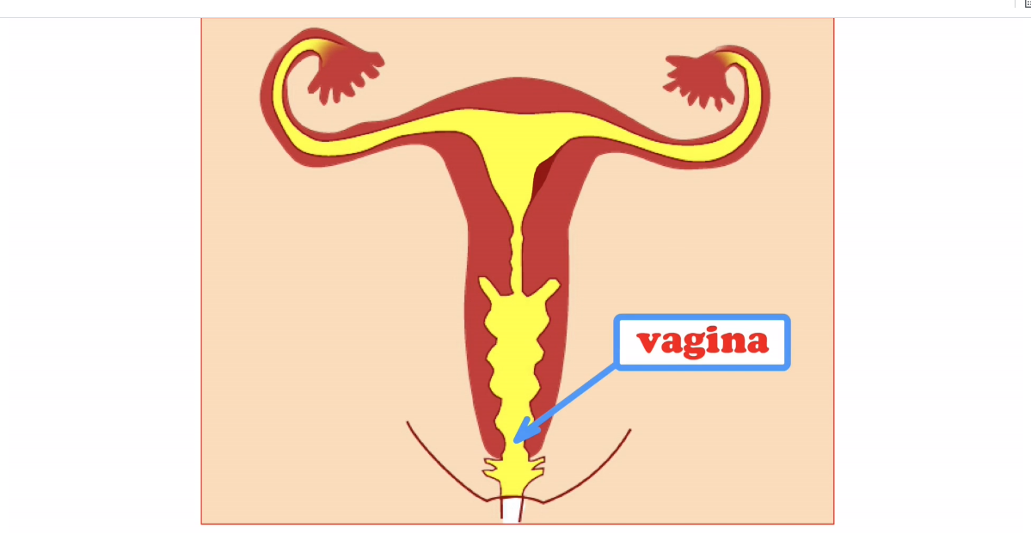

Slide 10
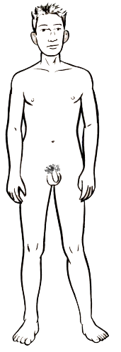
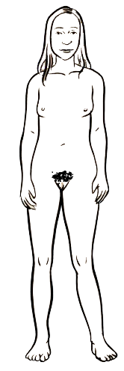
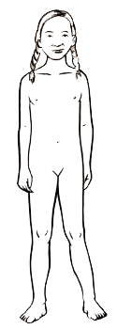
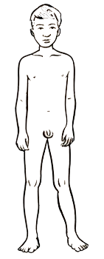
RECAP - The changing body
Males:
Females:
Muscle increases
Penis and testicles grow
Grow pubic hair
Grow taller
Get spots and sweat more
Get oilier skin and hair
Get a deeper voice
Wet dreams – ejaculation
Grow breasts
Hips and waist change shape
Grow pubic hair
Grow taller
Get spots and sweat more
Get oilier skin and hair
Get a deeper voice
Menstruation - periods
Images ©Family Planning Association NZ

